Slide 1

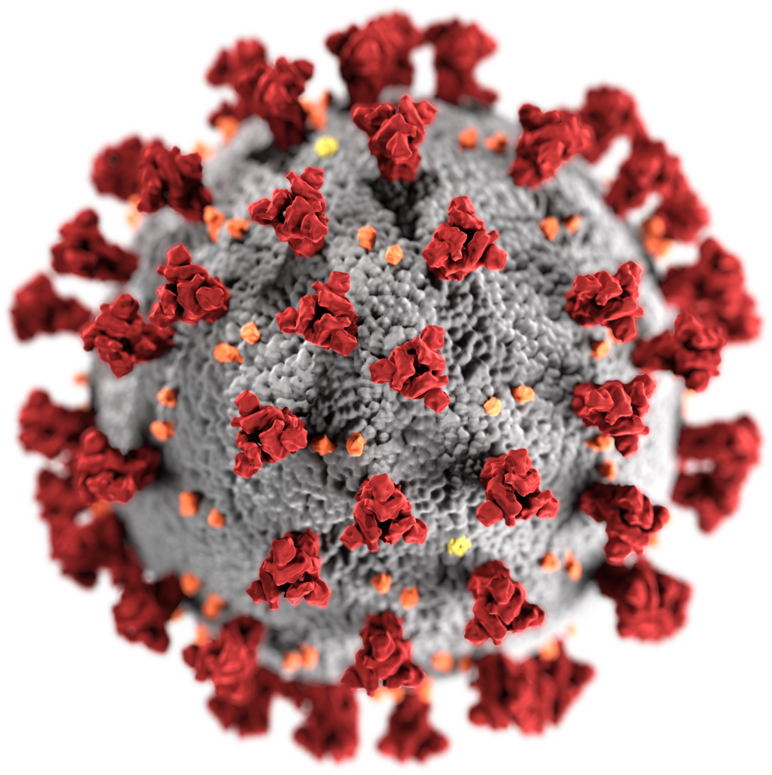
COVID-19
Burning ISSUES AND SOLUTIONS

Slide 2
Problem statement
We see various problems faced by general public regarding the implementation of the regulations related to COVID-19 vaccination.
No planning/documentation is done for various entities in this pipeline for vaccination and hospitalization.
In certain parts of the country, there is scarcity of Remedisivir injections, and prices are sky-rocketing.
Resources are not tracked properly based on supply/demand.
Many cases of sheer negligence and ignorance by the authorities involved in the procedure have been observed.
There is no single source of reliable information. Different sources often give contradicting information.

Slide 3

Can we solve this problem with Technology ?
The government alone cannot solve the current crisis . The IT Industry is experienced in handling logistical problems like this and we can come up with a solution to solve this problem.
We can use the latest technology (AI/ML, data science, IOT) to develop the application.
Each district collectorate can be assigned a team of IT professional experts (comprised of Project managers, Scrum masters, Data Analysts, Data engineers, I team, Customer Care executives) who will help them to coordinate, execute and streamline their day-to-day operations and communication to other departments.
We can request all veterans in the IT field to brainstorm to build a unified application which would be the single source of reliable data on all COVID-19 related activities for the general public and official authority.
Using technology We aim to reduce the burden on the government and at the same time contribute to a noble cause of helping the common public.

Slide 4
Proposed Solution
This application would help the Health Department /Government officials to decisions and plan their inventory for next few days and basically provide real time analytics.
We can keep track of the vaccine given to each individual.
We can track the date for next dosage for each person at the vaccination center and update demand accordingly.
It will also show the availability of vaccines in each center, so that vaccines can be refilled as per demand.
We'll also display the availability of oxygen cylinders and doctors available.
Logistics involved in the chain procedure of demand and supply can be handled effectively.

Slide 5


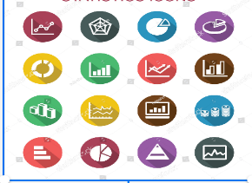
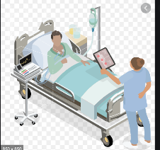

Proposed Solution
Vendors/suppliers
Application Users
Bharat Biotech/Serum
Vacine providers
Dash board /live Metrics
Live metrics for general public to alert the situation
remdesivir manfucter’s
Centralized Database for all future course of actions
Oxygen Suppliers
/other medical items vendors
AI/ML Prediction for Capacity planning
State Higher
Officers review
Dashboards/Analytics for
Decision making and arrange the logistics
Hospital staff/Admin will enter covid patient data
Vehicle Tracking Data
Though Mobile/web app Hospital authoirty enter covid patient information for every 1 hour
based up on date we can do Geo tagging for micro containment zone
Normal public who confirmed as covid positive home isolated persons can enter their details through mobile app/web with covid report they get precaution and doctor help over phone
District Health officers/collectors/municipal Teams monitor the system and can plan logistics accordingly
State Disaster Controller/Department Heads(Health,Munciple/IT)
Central govt Helath Department/WHO Team also can monitor data on real time basis

Slide 6
Uses of this application
Real time monitoring for better decision making
States can take central government help if situation is out of control
Even state /central government can deploy their teams and human resources in most effected places.
Triggering the alerts like oxygen ,medicines to suppliers ,vendors in advance
We can use this data for micro continment zone announcement
People can aware what’s happening their surrounding over internet on Realtime basis through trusted source they can take precatutions and safety measures
If we have covid patient data handy with government agencies unfortunately if any head of the family member lost life because of covid government /private companies can extend help to their family with incentive or they extend their help to come out this tragedy like providing Food items for few months,jobs for immediate family members in private sector.
These are few benefits like this we can leverage this data to provide other service as well and we can use this application for other purpose as well in later stage.

Slide 7
If government don’t want to take HYSEA/NASSCOM /individual IT employees/Volunteer help they can ask Below government entity’s help to build this plot form application as well where ever required our help we will contribute
https://www.cgg.gov.in/
https://t-hub.co/
https://www.nisg.org/
https://it.telangana.gov.in/
https://www.cdac.in/
https://cert-in.org.in/
Cost :
We all from different IT companies with cross functional skill will come forward voluntarily to build this application and same time we reach out to Microsoft,Google,AWS to provide cloud infrastructure to build this
If still required some money to provide laptop/desktop in remote places and tier 1 and tier 2 hospitals we can contribute from our pockets and also collect funds from crowd funding plot forms

Slide 8
Motto for this
Since we build and delivered world class mission critical applications from India/ to different parts of the world to the fortune companies can’t we leverage this experience and skills for noble cause and to solve current problem and save common man from this pandemic situation using technology .
Let us put all of our collective efforts to build this great product and demonstrate our Tech capabilities to the rest of the world.

Slide 9
Team members:
Anjaneyulu Nagunnoori
Venkata Kavati
Uppu purushotam
Ranjith B
Gunjan Gupta
Samrudhi shastri
Ananya Amarcherla
Ayush Goyal

Slide 10
Thank you For your time

